Slide 1

JSS SMI UG AND PG STUDIES,DHARWAD
Bachelor of Science (Computer Science)
presents
PROJECT PRESENTATION
on
“BOMBAY NOVELTY E-STORE”
Project Guide: Mrs.Renuka Mathapati
Submitted by:
Aishwarya Rokhade
Priyanka Rokhade

Slide 2


“Bombay Novelty
E-store”

Slide 3
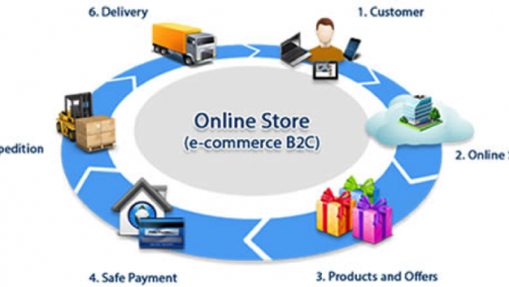
INTRODUCTION

Slide 4

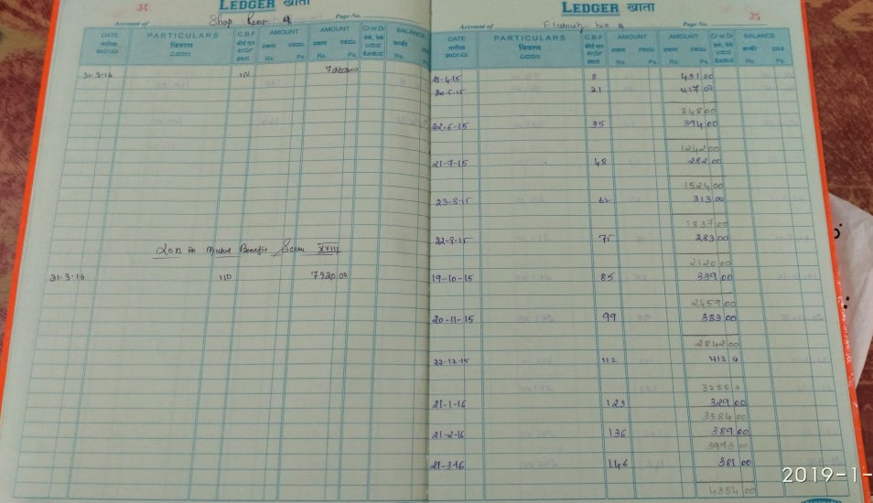


OBJECTIVES
EXISTING SYSTEM PROPOSED SYSTEM
TRANSFORMATION
TRANSFORMATION

Slide 5
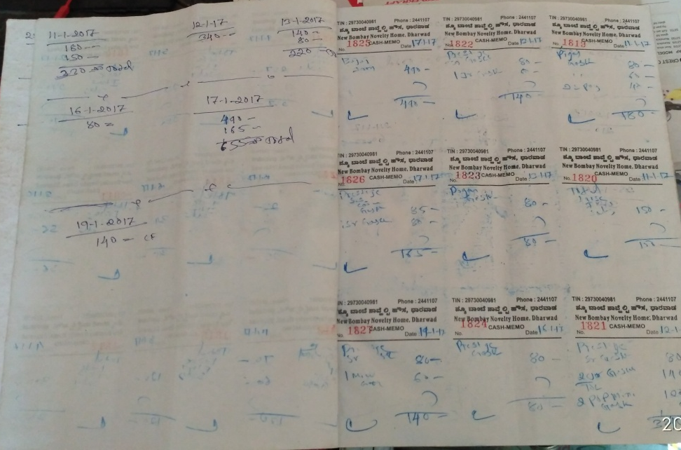
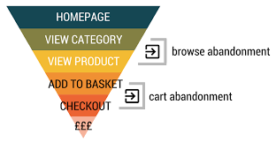
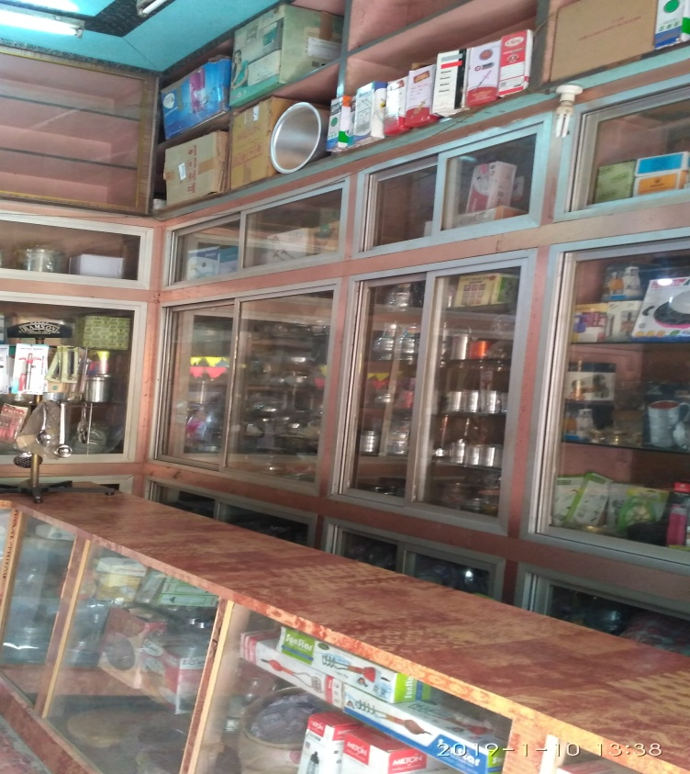
TRANSFORMATION
TRANSFORMATION

Slide 6

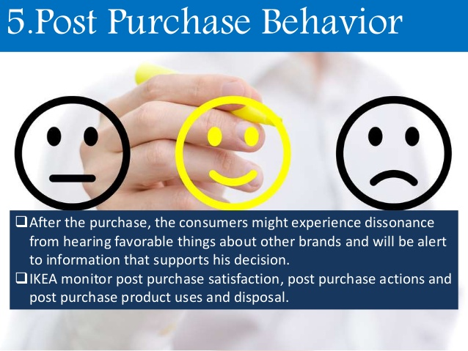
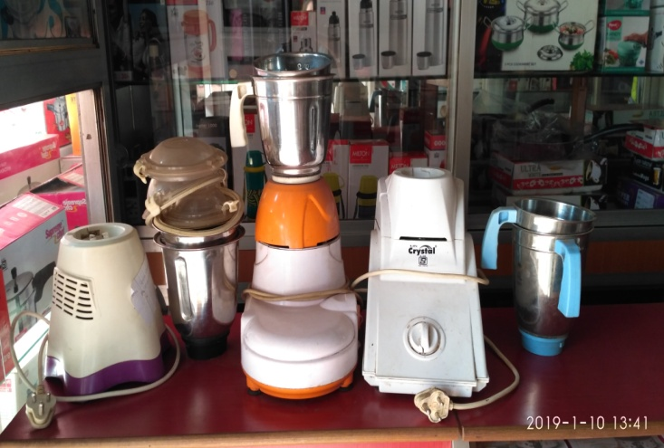





Slide 7
MODULES
Administrator
Category
Stock Items
Supplier
Purchase Details
Bill
Order view
Report
Customer
Registration
Category
Product
Order
Payment
MBScheme
Exchange offer
Service
Feedback

Slide 8
TOOLS/PLATFROMS LANGUAGES TO BE USED
SOFTWARE REQUIREMENTS
Platform :Web Application
Operating system :Windows 7 and others
Database :My SQL
Front end :HTML, CSS, java script
Language :Python
Framework : Django
Browser :Any of Chrome, Opera, Mozilla Firefox
HARDWARE REQUIREMENTS
Processor :Intel Core i3
Hard disk space :500GB
RAM :2GB

Slide 9
PROCESS LOGIC
INPUT OUTPUT
Customer information
Stock information
Purchase information
Supplier information
Product information
Login process
Search process
Order process
Purchase process
Billing process
Order details
Payment details
Delivery details
Product details
Billing details
Report details

Slide 10
DATA FLOW DIAGRAM
DFD: LEVEL 0
DB
Stock update
0
Online
Shop
Admin
Purchase details
Customer
Supplier
Payment details
Delivery details

Slide 11
DFD: LEVEL 1
Admin
Supplier
Admin
details
Supply
details
Order
requirements
1
Login
Process
2
Stock
maintain
3
Order
Process
4
Search
Process
Item
Details
5
Purchase
process
6
Billing
Process
Product
view
Order
details
product
details
Payment
details
Product
details
Delivery
details
Customer
details
Customer
7 Delivery
Process
DB

Slide 12
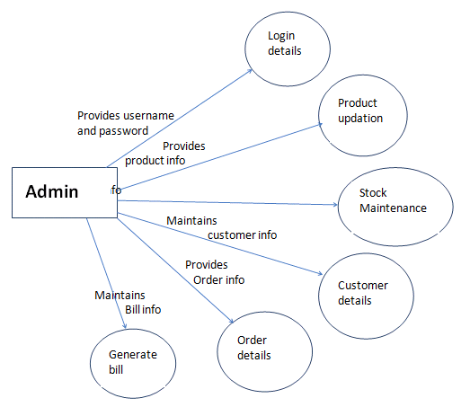
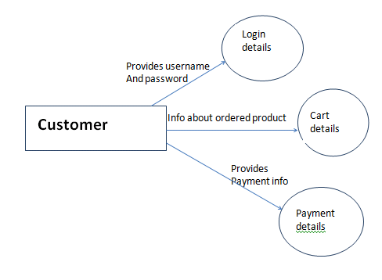
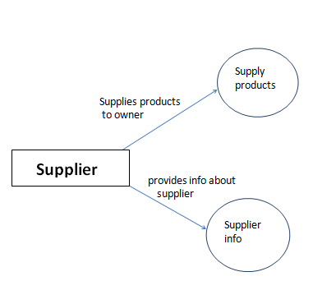
LEVEL 2

Slide 13
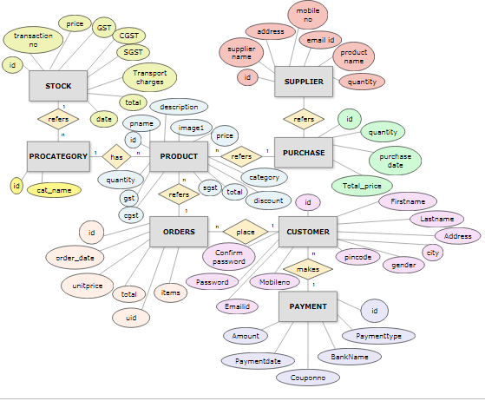
ER DIAGRAM
1
n

Slide 14
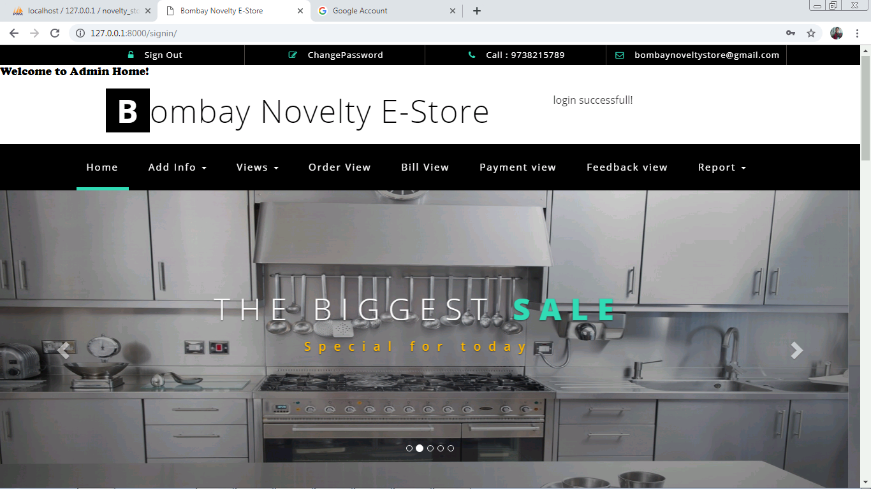
SNAPSHOTS
ADMIN HOME PAGE

Slide 15
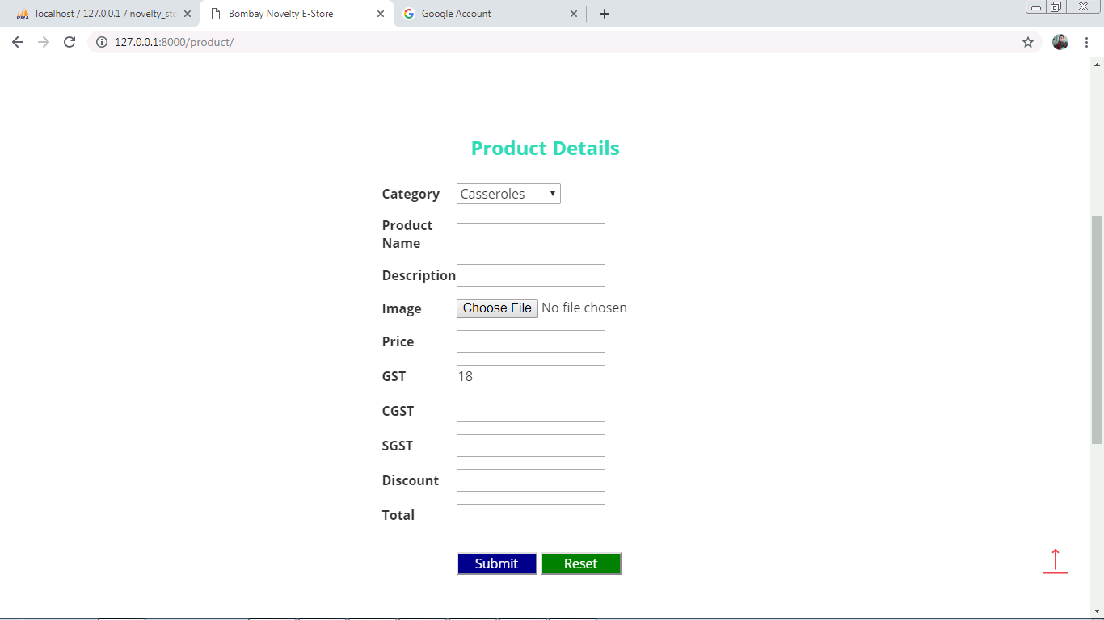
ADMIN→ADD PRODUCT PAGE

Slide 16
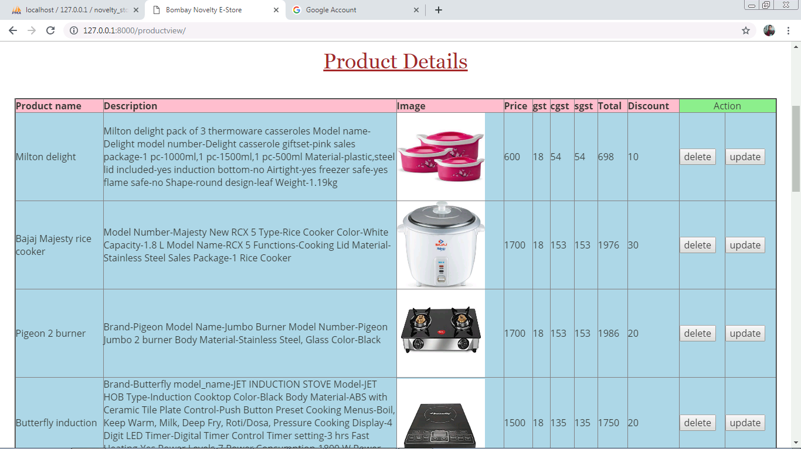
PRODUCT VIEW PAGE

Slide 17
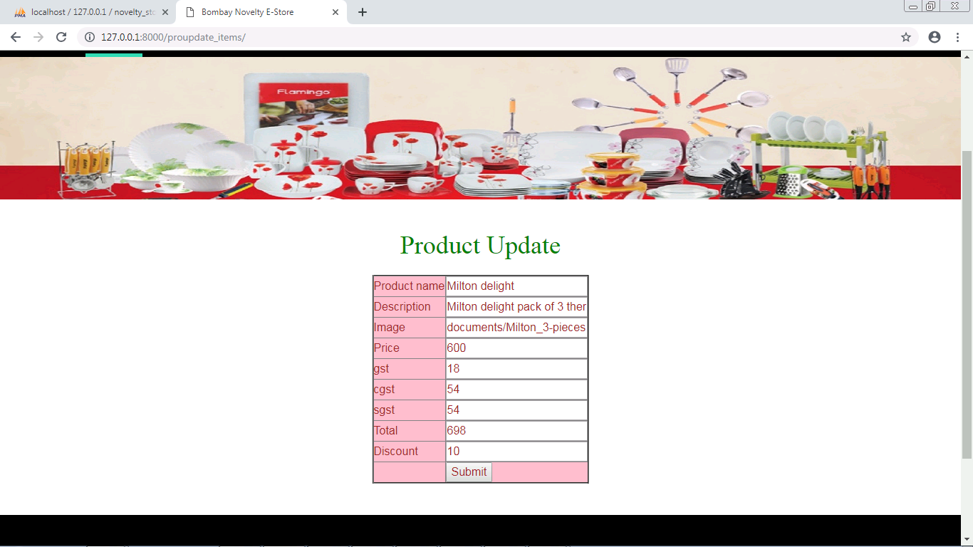
PRODUCT UPDATE PAGE

Slide 18
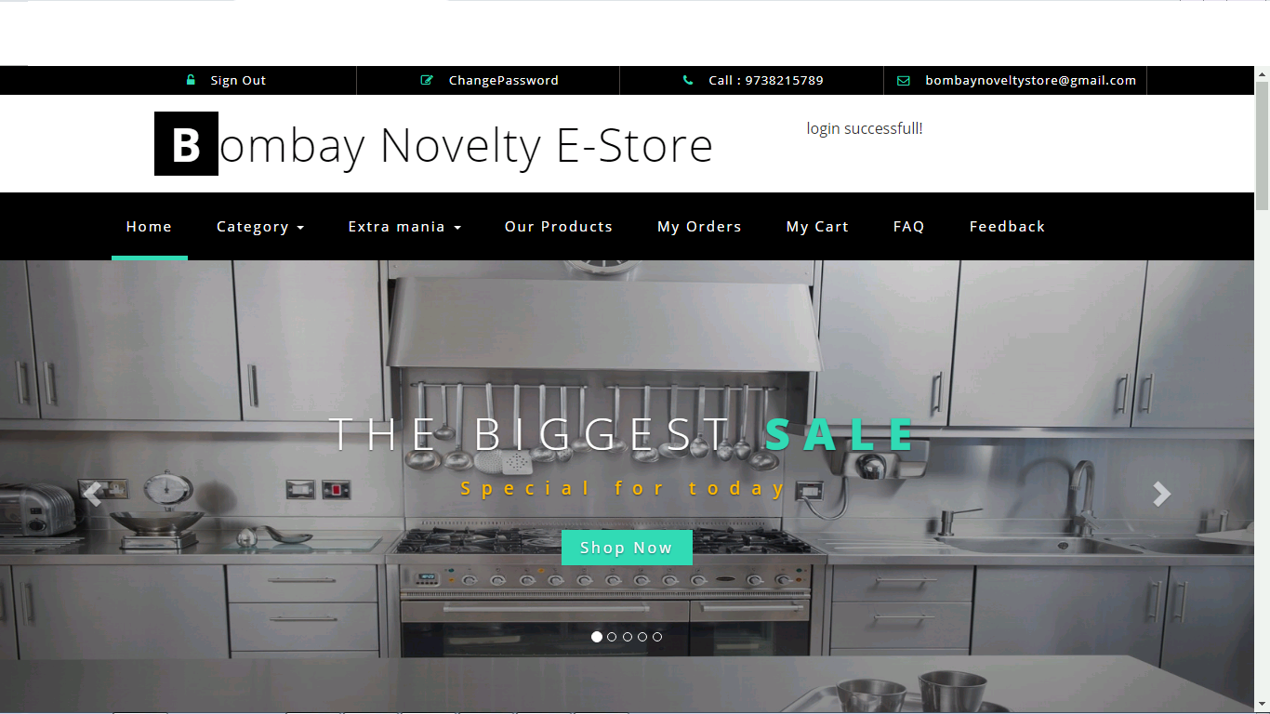
CUSTOMER HOME PAGE

Slide 19
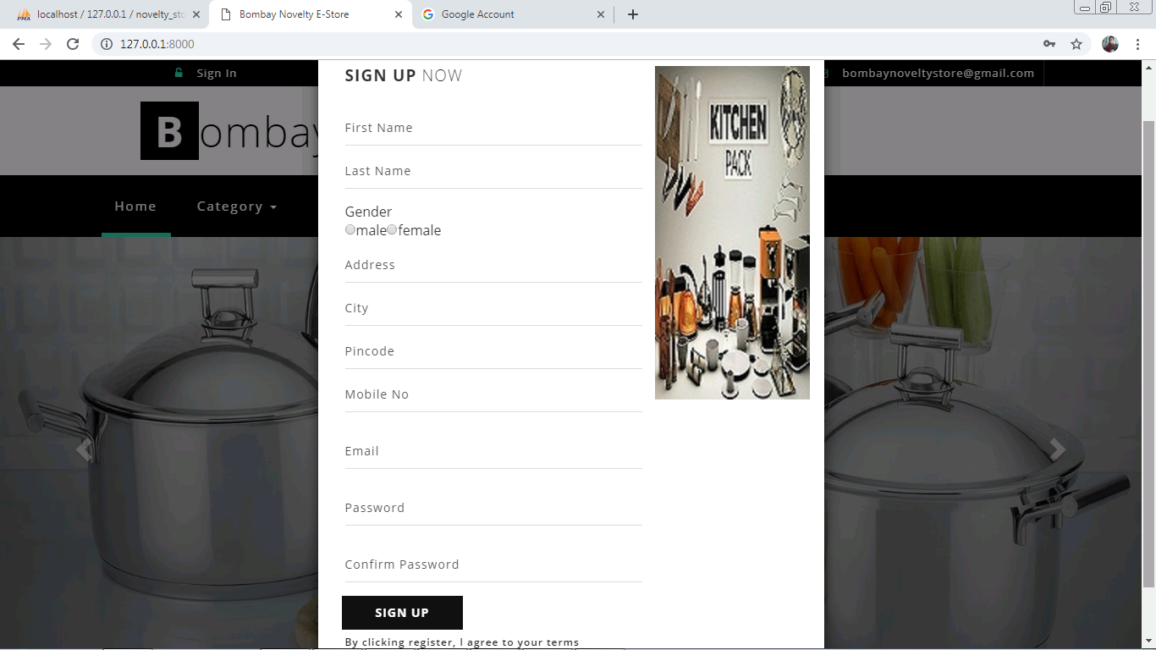
SIGN UP PAGE

Slide 20
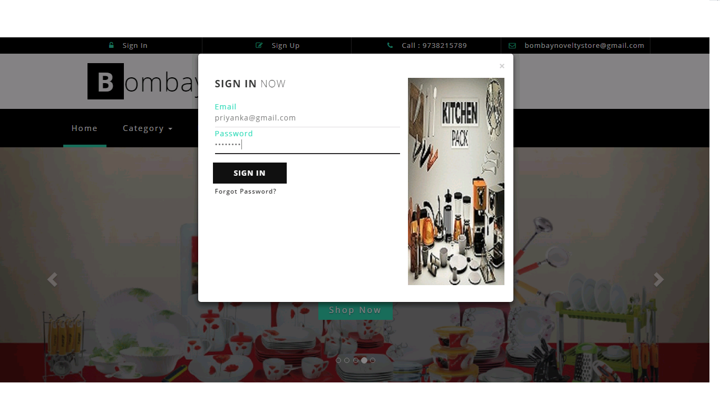
LOGIN PAGE

Slide 21
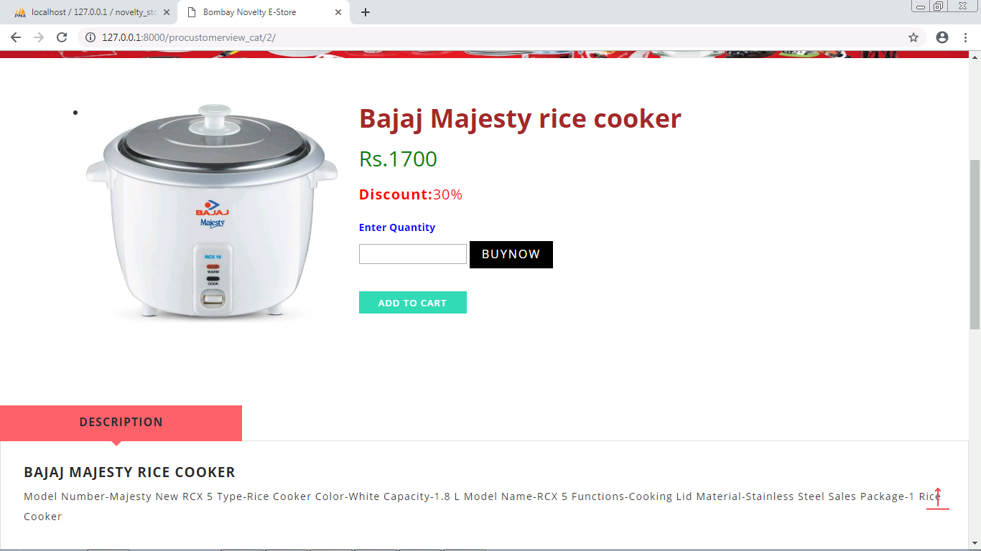
OUR PRODUCTS

Slide 22
LIMITATIONS OF THE PROJECT
Although our software presents a broad range of options to its users past records could not be covered into it.
Presently we are adding limited stocks.
Invoice messages like SMS cannot be provided currently.
Cash on delivery facility will be given to customer only by cash.

Slide 23
SCOPE OR FUTURE APPLICATION
Multiple language facility can be given.
If any new category is introduced can be added.
It can also be part of android application.
Barcode reading can be provided.
Net banking and other facilities for transactions can be provided.

Slide 24
THANK YOU

